Slide 1



Streaming & Cloud
May 2023
Attila Szűcs
attila_szucs@epam.com
Data Engineering, Architecture

Slide 2




Where We Are?
NoSQL
Big Data (Batch)
Both use distributed computing to store & process large amount of data
INV-002
Solution for: How to store the data so that we can run real-time queries
Latency: milliseconds (real-time)
Solution for: How to run ad-hoc queries on any (semi-structured) data
Latency: minutes, potentially hours

Slide 3
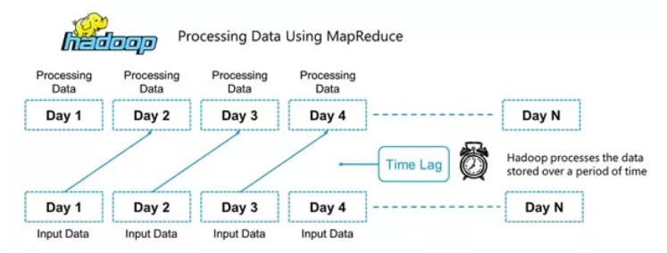
Batch Processing
Processing the data collected over a time period
Traditional Big Data is batch processing
Results are not real-time; we need to wait for the next “batch”
INV-001
INV-002

Slide 4

STREAM PROCESSING

Slide 5
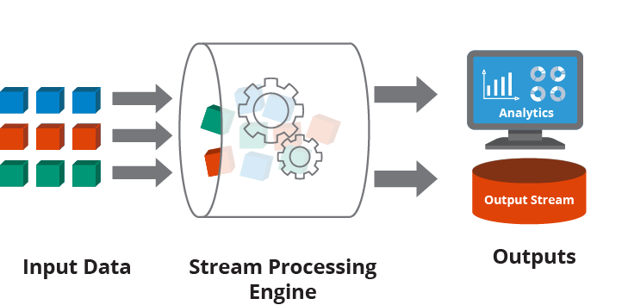
STREAM Processing
Definition:
Stream processing is the practice of taking action on a series of data at the time the data is created.
INV-001
INV-002
An overview on Hazelcast

Slide 6
Streaming challenges
State management
Event time vs processing time; late events
{"value": 23, "ts": "2021-04-13T12:30:00Z"}
State
{"value": 17, "ts": "2021-04-13T12:35:00Z"}
Time received
{"value": 10, "ts": "2021-04-13T12:40:00Z"}
{"value": 11, "ts": "2021-04-13T12:33:30Z"}
{"value": 51, "ts": "2021-04-13T12:45:00Z"}
Traditionally it was considered in-accurate and unreliable

Slide 7
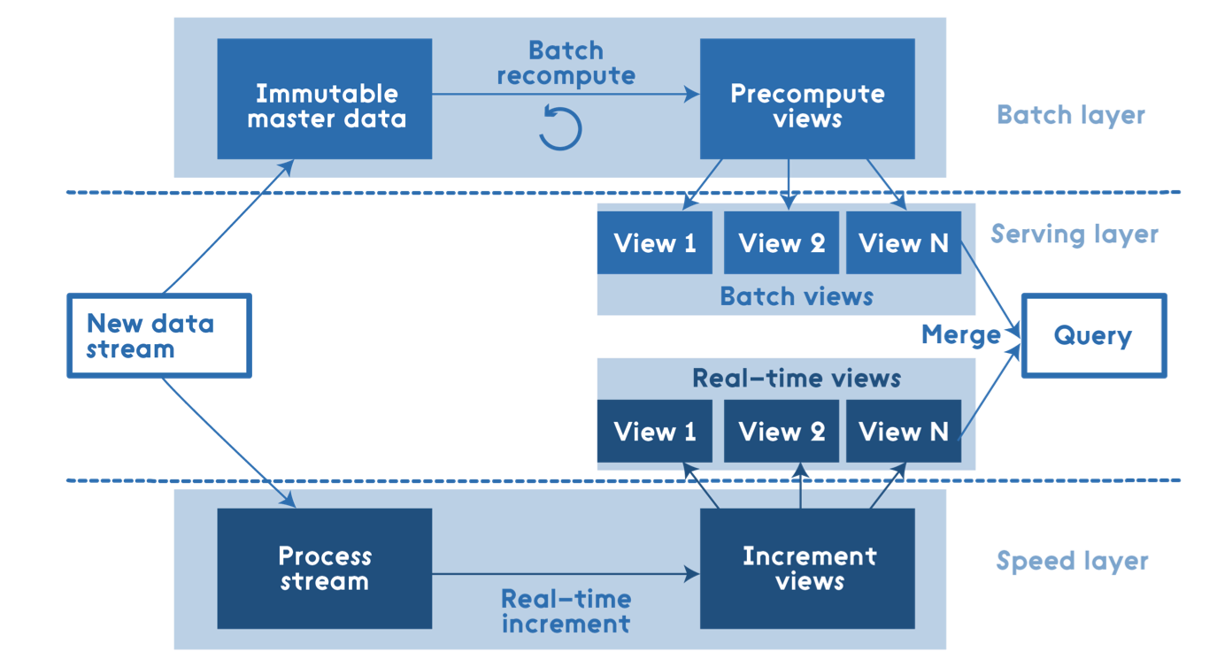
Lambda Architecture
Attempts to balance latency, throughput, and fault-tolerance by
using batch processing to provide comprehensive and accurate views of batch data,
while simultaneously using real-time stream processing to provide views of online data.
INV-001
INV-002
Disadvantages
Two codebases, need to be in sync
Complex architecture, specialized tools

Slide 8
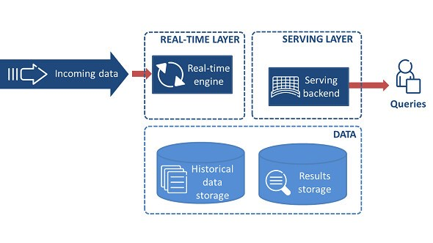
Kappa Architecture
Is a software architecture used for processing streaming data. The main premise is that you can
perform both real-time and batch processing with a single technology stack.
INV-001
Everything is a stream
Batch operations become a subset of streaming
Keep it short and simple (KISS) principle.
A single analytics engine is required
Coding and maintenance are simpler
Immutable data sources
Data source is persisted, and views are derived
State can always be recomputed from source
Replay functionality
Computations and results can evolve by
replaying the historical data from a stream
INV-002

Slide 9
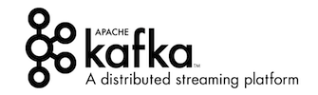

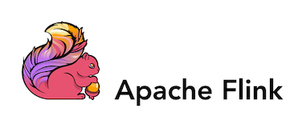

Agenda
Handling events
Processing events
Apache Kafka is a distributed data store optimized for ingesting and processing streaming data in real-time.
Simplified definition: Persistent & scalable messaging platform
Spark streaming is an extension of the core Spark API that enables scalable, high-throughput, fault-tolerant stream processing of live data streams.
Spark streaming workshop
INV-002

Slide 10
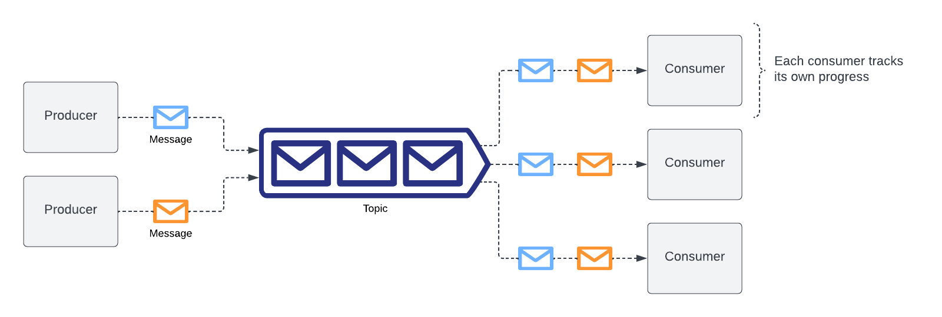
Kafka – Messaging Platform
Decouples source and target systems
Reduces integration complexity
Each consumer receives all messages (by default)

Slide 11
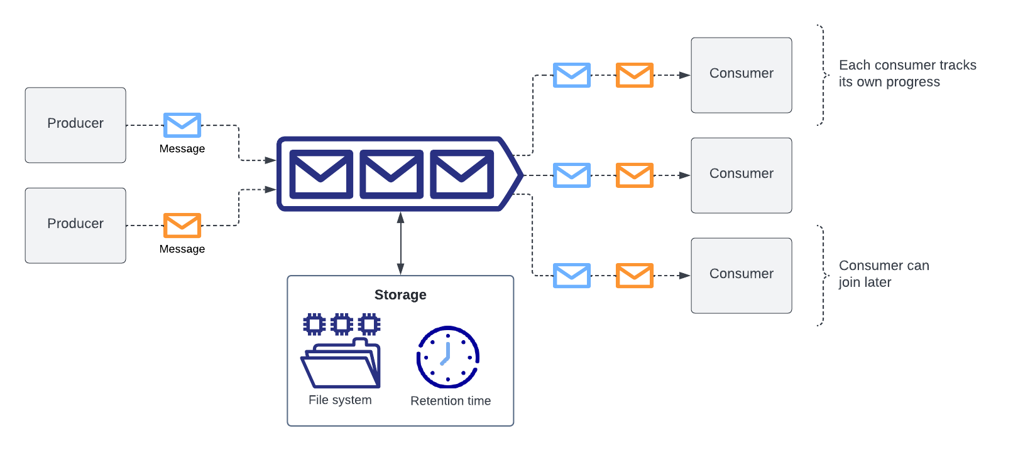
Kafka – Persistent Storage
Retention time can be seconds / days / years / infinite
New consumers can be added later

Slide 12
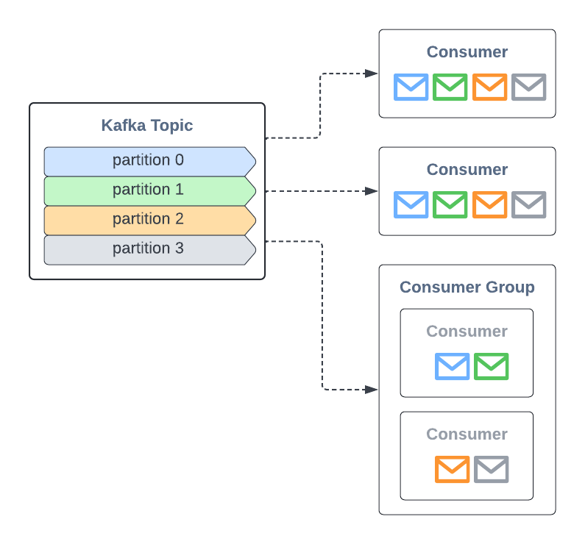
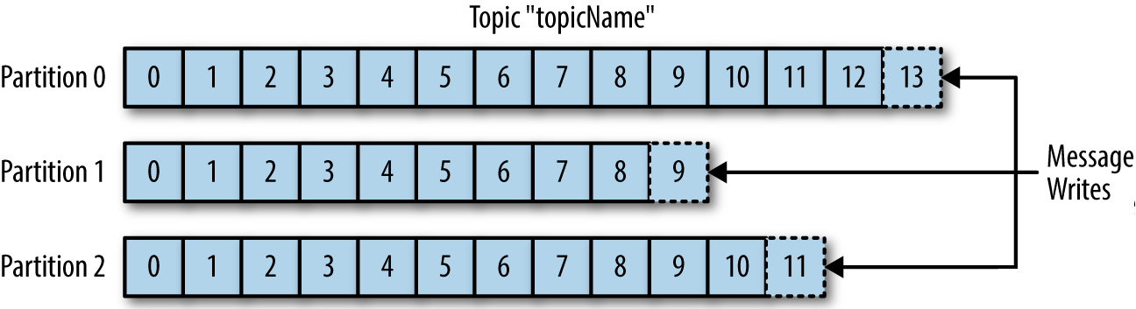
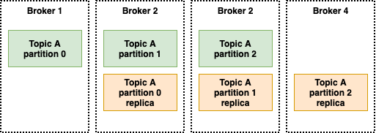
Kafka – Scalability
Scaling Storage
Scaling Consumers
Standalone consumers receive all messages
Consumers from a consumer group share the partitions among them
Topics can be partitioned and replicated just like NoSQL tables
Kafka cluster nodes are called “brokers”

Slide 13
Agenda
Handling events
Processing events
Apache Kafka is a distributed data store optimized for ingesting and processing streaming data in real-time.
Simplified definition: Persistent & scalable messaging platform
Spark streaming is an extension of the core Spark API that enables scalable, high-throughput, fault-tolerant stream processing of live data streams.
Spark streaming workshop
INV-002

Slide 14





Stream Processing – Concepts
Transformations
Source
Files
Kafka
Socket (testing)
Rate (testing)
...
Triggers
Default (microbatch)
Fixed interval
Once
Continuous (experimental)
Sink
Files
Kafka
Foreach
Console (testing)
...
Output modes
Append (default)
Update
Complete

Slide 15
Spark Streaming – APIs
DStreams | Structured Streaming
Low level | Higher level
Functional | Relational
No event time support | Built-in event time support
Microbatch only | Microbatch & continuous (experimental)
RDD integration | Structured API integration

Slide 16
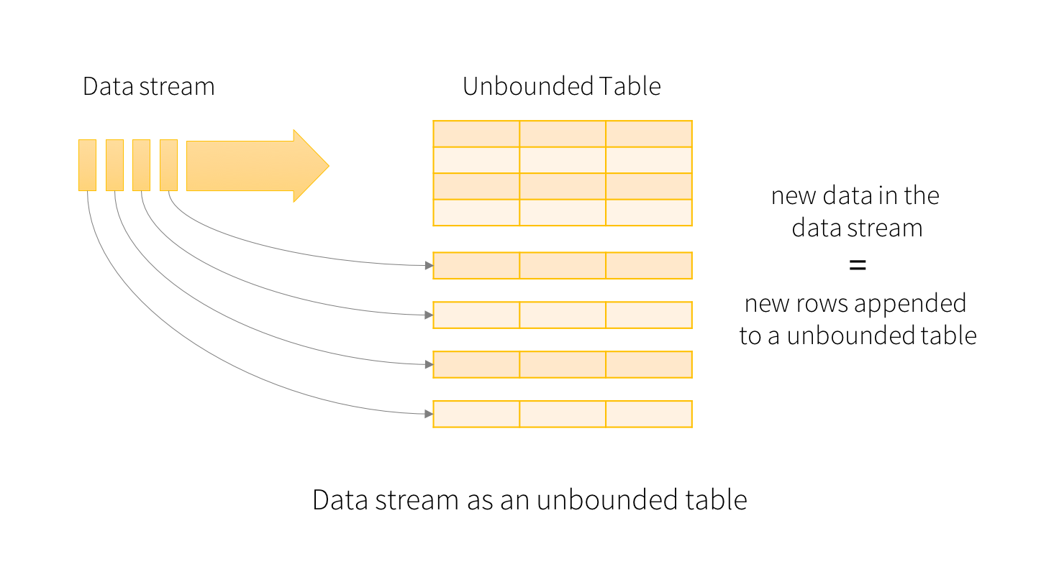
Spark – Structured Streaming
Spark’s DataFrame API can be used
Streams are (unbounded) data frames
Operations on unbounded data frames result in unbounded data frames
The same API can be used for both batch and stream processing

Slide 17
Structured Streaming
Dataframe API
// input stream
val input = spark.readStream
.schema(schema)
.json("/path/to/folder")
// transformation
val countStream = input
.where("size > 10")
.groupBy("category")
.count()
// output stream
val outputStream = countStream.writeStream
.outputMode("complete")
.format("console")
// start streaming app
outputStream.start()
Transformations
Simple transformations
Aggregations
Joins
Stream-Static
Stream-Stream
Limitations apply

Slide 18

Demo – Spark Structured Streaming
Source code available on
medvekoma/streaming-workshop

Slide 19
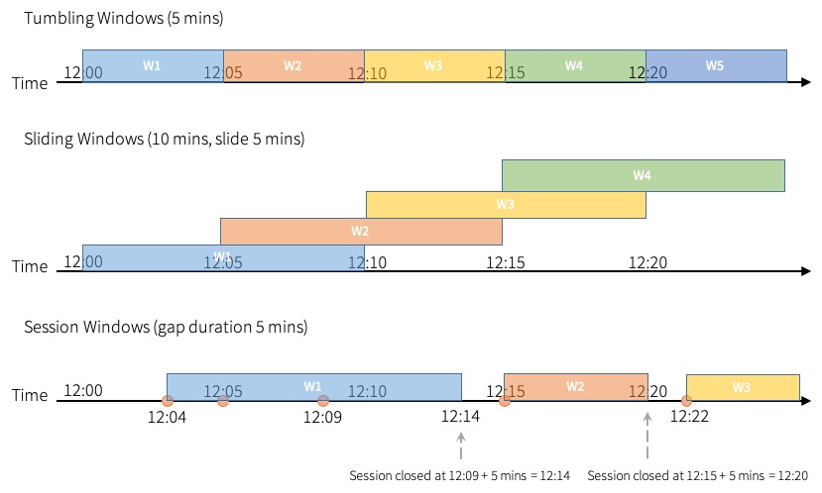
Event time & Time Windows
Event time != processing time
Event time is usually a field in the data
Often, we group the data by event time windows
Window types
Tumbling windows
Sliding windows
Session windows

Slide 20
Event time Windows – Tumbling Windows
2
3
1
Window types
Tumbling window
streamingDF
.groupBy(
window(col("event_time"), "15 minutes"))
.count()

Slide 21
Event time Windows – Sliding Windows
2
4
2
Window types
Tumbling window
Sliding window
streamingDF
.groupBy(
window(col("event_time"), "15 minutes", "10 minutes"))
.count()

Slide 22
Event time Windows – Late Events
4
4
2
Window types
Tumbling window
Sliding window
streamingDF
.groupBy(
window(col("event_time"), "15 minutes", "10 minutes"))
.count()
Late events

Slide 23
Event time Windows – Watermarks
3
4
2
Window types
Tumbling window
Sliding window
streamingDF
.withWatermarks("event_time", "30 minutes")
.groupBy(
window(col("event_time"), "15 minutes", "10 minutes"))
.count()
Late events
Watermarks

Slide 24
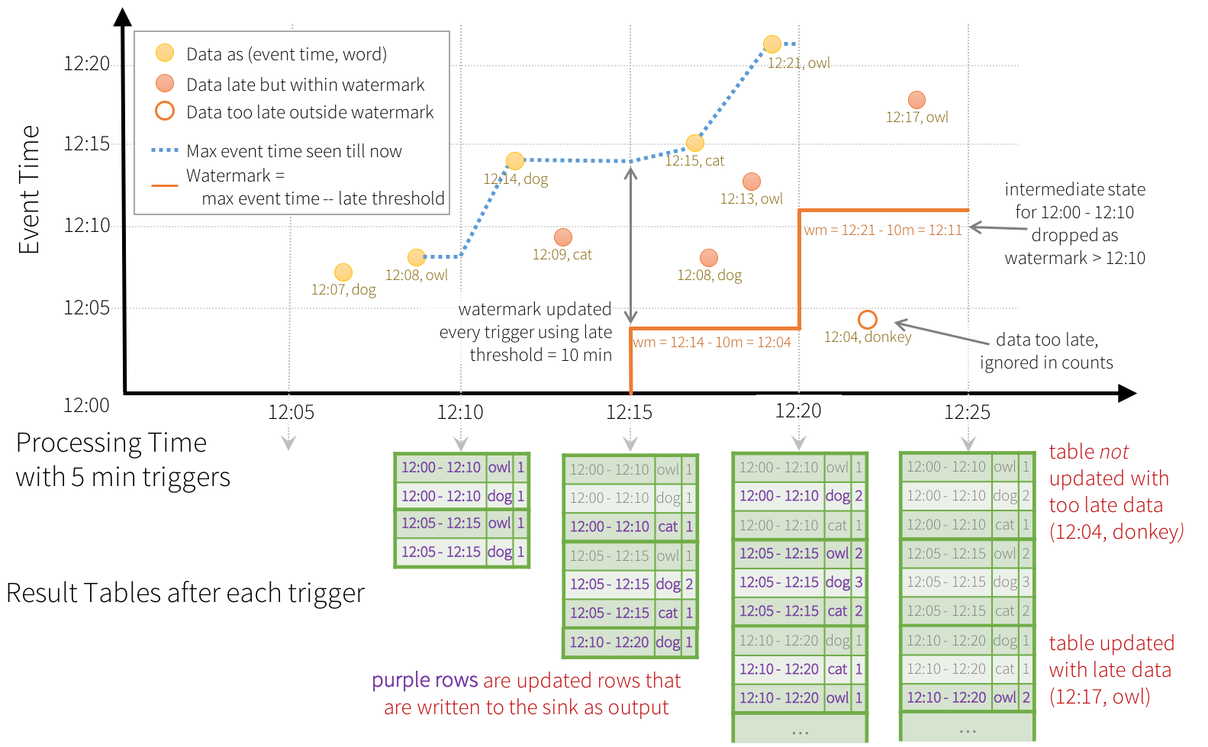
Late Events and Watermarks
More info: Structured Streaming Programming Guide

Slide 25

Streaming – Take Away
Apache Kafka is a persistent, scalable messaging platform
Structured Streaming is „Dataframe but streaming”
A stream is an unbounded table
The same API for batch and streaming
Event time != processing time
Late events & watermarks

Slide 26


Questions?

Slide 27

Cloud Computing

Slide 28
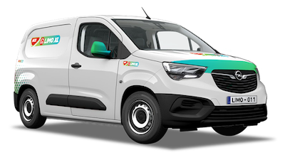
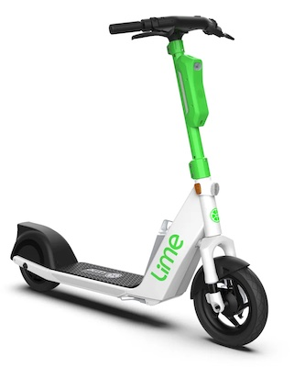
Cloud Computing
Cloud computing:
Delivery of computing services over the internet (servers, storage, databases, software, etc.)
”Renting” IT services over the internet
INV-002
INV-001
Types
Infrastructure as a Service (IaaS): Rent resources like servers, networking, data centers
Software as a Service (SaaS): Rent software applications
Serverless: Allows developers to create applications without thinking about infrastructure
Advantages
Scalable infrastructure
Globally accessible resources
Reliable IT services
Robust security

Slide 29



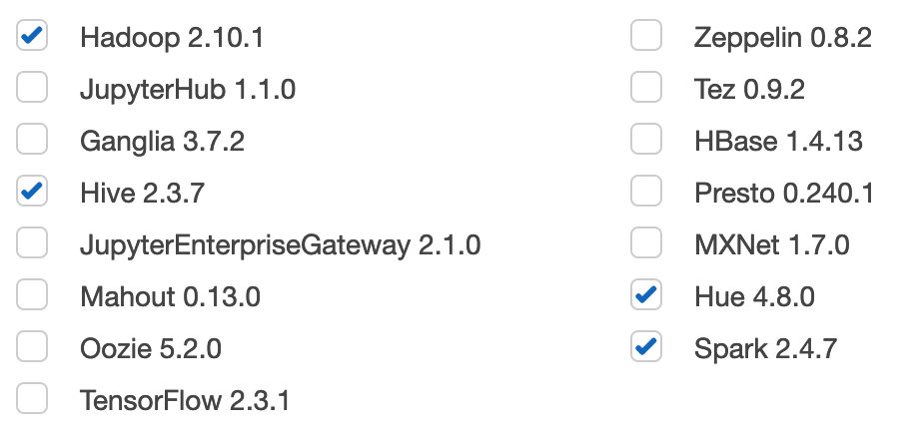
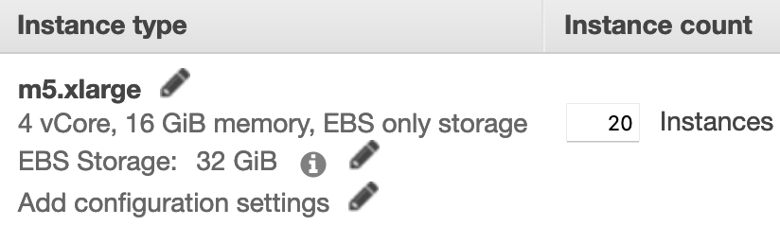
Cloud – Hadoop As a Service
INV-002
Google Cloud
DataProc
Microsoft Azure
HDInsight
INV-001
Advantages
Managed service, less operational costs
Quick provisioning, on demand clusters
No up-front costs, pay as you go
Auto-scaling
Things to consider
Limited configuration
Country regulations
Cost (+10-25% on top of infrastructure cost)

Slide 30
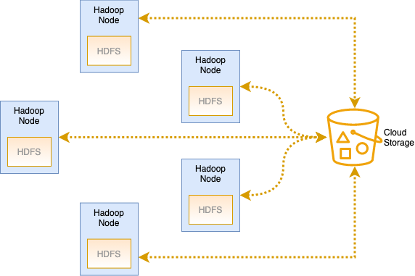

Cloud Storage
Object Storage in the Cloud
looks like a file system
distributed and replicated
inexpensive
99.999999999% durability
Can be used instead of HDFS
separate storage from compute
ephemeral clusters
more clusters can work on the same data
Think about it: end of data locality?
Partially
High-speed networking
Benefits outweigh drawbacks

Slide 31
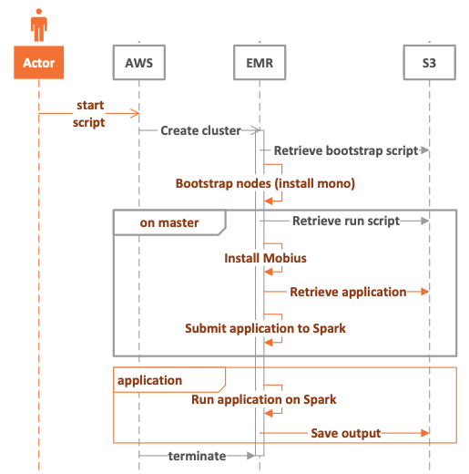
Cloud – Ephemeral Clusters
Infrastructure as Code
Provision cluster
Install additional software (if needed)
Start application
Terminate cluster on completion
Example: scalable workload – larger cluster
Reduce execution time
(almost) the same costs
Cluster size | Hourly cost per node | Execution time | Total Cost
5 nodes | $1 | 4 hours | $20
20 nodes | $1 | 1.1 hours | $22

Slide 32
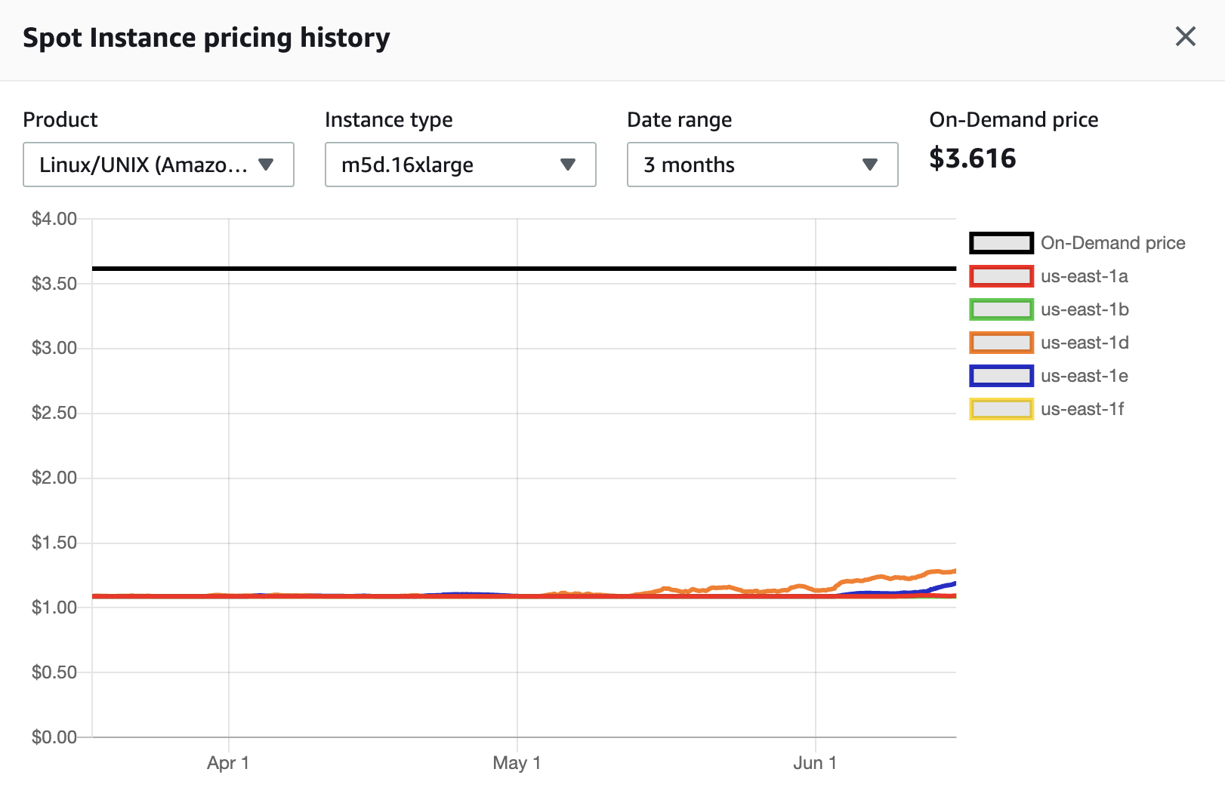
SPOT INSTANCES – SPARE RESOURCES CHEAPER
 | EC2 | EMR | Total | Relative Cost
On Demand | $ 3.616 | $ 0.27 | $ 3.886 | 100 %
Reserved 1 year | $ 2.278 | $ 0.27 | $ 2.547 | 65 %
Spot | $ 1.300 | $ 0.27 | $ 1.570 | 40 %
Spot Block 1 hour | $ 1.989 | $ 0.27 | $ 2.259 | 58 %
Spot Block 6 hours | $ 2.531 | $ 0.27 | $ 2.801 | 72 %

Slide 33
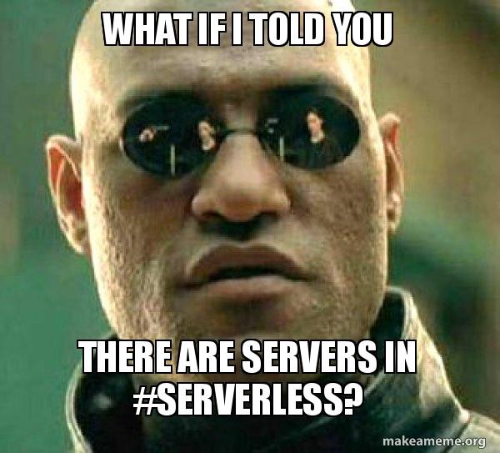
Cloud – Serverless
Serverless Computing
an execution model in which the cloud provider
… dynamically manages the allocation of resources
Servers are unimportant
The cloud provider manages them internally
Resource details are hidden from us
We only care about code, performance and cost
Costs
Traditional: pay for the resources + services
Serverless: pay for the usage (execution time, amount of data, etc.)

Slide 34
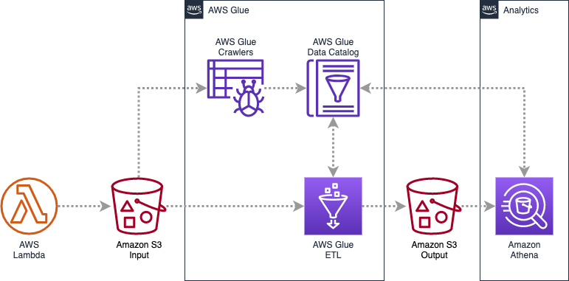
Cloud – Serverless In Big Data
AWS Lambda
Function as a service
Triggers execution
AWS Glue Data Catalog
Metastore as a service
AWS Glue ETL
ETL as a service (e.g., Spark)
Amazon Athena
Analytics as a service (presto)

Slide 35
Cloud – Take Away
Hadoop as a Service
Infrastructure as Code
Cloud storage: separate storage from compute
Dynamic cluster sizes: Autoscaling
Dynamic clusters: Ephemeral clusters
Serverless: Focus on code, forget infrastructure

Slide 36

Conclusions

Slide 37

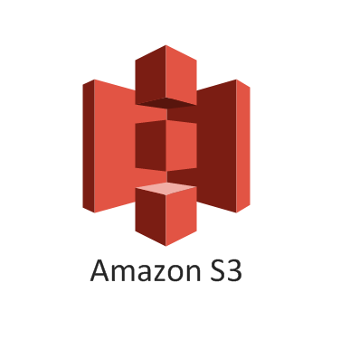

EXAMPLE PROJECT – DATA PLATFORM
RDBMS
Streaming
Platform
Apps
Events
Query Layer
Data Lake
Web Analytics

Slide 38


Career Paths in Data
Data Engineer
Data Scientist
Activities
develops, tests & maintains data pipelines
prepares data for Data Scientist
builds infrastructure
Skills
development (Java, Scala, Python)
linux, docker, kubernetes
cloud infrastructure (terraform)
big data (Spark, Kafka, ...)
Activities
cleans & organizes data
analyses data to develop insights
builds models and solves business needs
Skills
math, statistics
development (Python, R)
ML, statistics libraries
some big data (Spark)

Slide 39


About EPAM MEP
The Mentoring Program is our in-house upskilling program that allows you to learn from our EPAM experts.
The program will give you the chance to acquire the right knowledge to become one of EPAM’s technologists.
Java
.NET
Test Automation
DevOps
Data Engineering
Interested? Apply here: https://epa.ms/edu-hungary

Slide 40

Questions?

